Slide 1
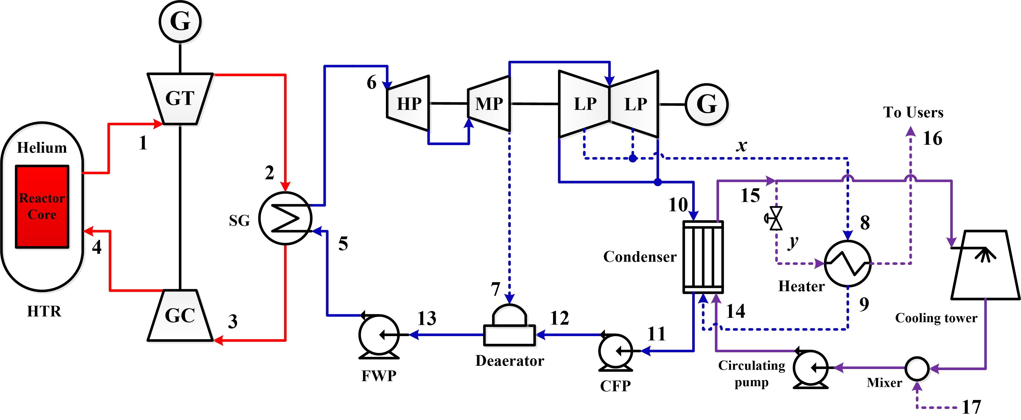
Semesterarbeit
Title: Thermodynamic analysis of a high temperature gas-cooled reactor-based combined heat and power (CHP) system
Begin: 05.25.2022
Type of the work: Simulation and Programing
Proposal date: 05.25.2022
Domain: Thermodynamic and system design
As a type of Generation-IV reactors, the high temperature gas-cooled reactor (HTR) is currently being actively investigated and developed due to its high reactor outlet temperature and inherent safety. In particular, the modular HTR can be used as a heat source to provide the people living in remote areas or islands with the heat and electricity required.
Based on this consideration, we think that it is very interesting to design a HTR-based combined heat and power (CHP) system and evaluate the thermodynamic performance of the system under different operating conditions.
Schematic diagram of a HTR-based CHP system
Tasks: 1. Complete the thermodynamic modeling of the system;
2. Perform the energy and exergy analysis;
3. Analyze the effects of key operating parameters on the system performance;
4. Write a semester work report.
Prerequisites: Knowledge of the thermodynamics;
Interest in thermodynamic system design and analysis.
Contact: M.Sc. Qi Wang, Room: 0430, Email: qi.wang@tum.de
Technische Universität München
Prof. Dr. Rafael Macián Juan ∙ School of Engineering and Design ∙ Dept. of Energy and Process Engineering ∙ Lehrstuhl für Nukleartechnik
Boltzmannstrasse 15 ∙ 85748 Garching ∙ Deutschland ∙ Tel: + 49.89.289.15620 ∙ Fax: +49.89.289.15622
info.nte@ed.tum.de ∙ www.epe.ed.tum.de/ntech

